Slide 1

Developing Web with Python 3 and Django Framework
By: Rian Irawan Hariadi
KOPDAR PYTHON 2017 Python ID Jakarta
February 18th 2017
PT IP Network Solusindo, Golden Centrum Complex,
Jl. Majapahit 26P, Petojo Sel., Jakarta, Indonesia

Slide 2
Introducing Me
RIAN IRAWAN HARIADI
Programmer, Forex Trader, Medical I.T.
“Loving Siberian Husky and female doctor”
Address: Bandung and Jakarta, Indonesia
Website: rianhariadi.com
Github : www.github.com/huskyin

Slide 3
Why Python for Website?
Python vs PHP : Python is FASTEST, except for PHP 7
Many modules
Big support
Google USES IT!

Slide 4
Why Django Framework ?
Reliable
Scalling Up Ready for BIG Website
Always Update → Now ver. 1.10.3
Many BIG websites USE IT: Pinterest, Instagram, Disqus, Reddit

Slide 5

My Projects With Django (1): Kursus Finansial Web
www.kursusfinansial.com
Indonesia Forex Trading and Derivatives Course

Slide 6

My Projects With Django (2): Profesi Medis
www.profesimedis.com
Social Media for Medical Workers

Slide 7
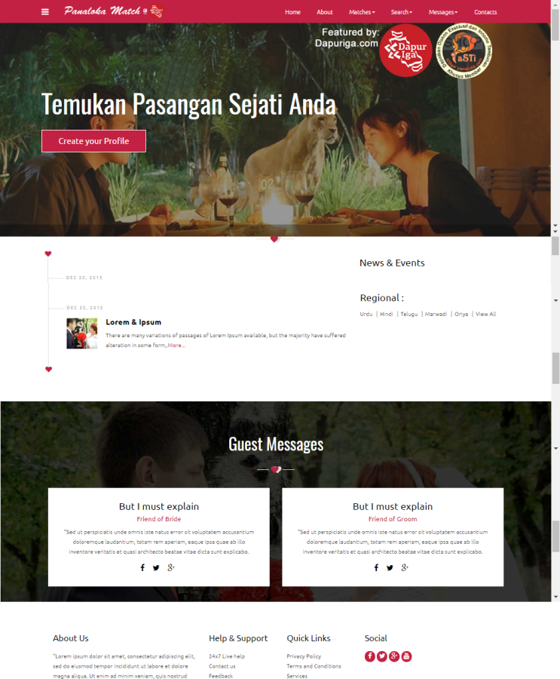
My Projects With Django (3): Panaloka Match App
www.panalokamatch.com
Dating Sites with multi user and 3 languages: Bahasa Indonesia, English, Mandarin

Slide 8
What do we need ?
Python 3.4
Virtual Environtment (virtualenv)
Django 1.10.3 or Higher (be careful deprecated!)
Postgresql database→ psycog2 as connector
BUT if we already have Python installed, we can use ONE CLICK with pip install –r requirements.txt

Slide 9
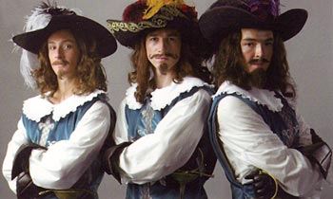
Django ‘Three Musketeers’ Files
manage.py → the ‘run’ file
settings.py → the ‘Fu**ing’ Matter of Django
ulrs.py → Where do you want to GO ?
manage.py settings.py urls.py

Slide 10
MVC vs MTV
Django works with 2 philosophies:
Model Template View (MTV)
DRY (Don’t Repeat Yourself)
___________________________________
Model → Connection Database with ORM
(Objects Relational Mapper)
Template → HTML Parsing System
View → Logic for Parsing

Slide 11
View Parsing to Template
from django.shortcuts import render
def index(request):
content = {‘title’ : ‘Website.com’}
content[“message”] = ‘Ini website saya’
return render(request,’index.html’, content,content_type=‘text/html’)
WARNING: UNLIKE PHP, in Python-Django you CAN’T embed HTML tags to content!!
Can’t be: content[“message”] = “<b>My Web</b>”

Slide 12
Template to HTML (index.html)
<!DOCTYPE html>
<html><head>
{% load static %}
<link href="{% static 'styles.css' %}“ rel="stylesheet">
<title>{{ title }}</title></head>
<body>
{% block content %}
<p>{{ message }} </p>
</body>
{% endblock %}
</html>

Slide 13
new.html
{% extends ‘index.html’ %}
{% block content %}
<h1>PESAN BARU: Selamat datang di python.id</h1>
{% endblock %}

Slide 14
Urls.py
Learn About Regular Expression:
url = (r’^$’,views.myfunct,name=“my_func”),
This url GOES TO function myfunct in views.py
^foo : ANYTHING before ‘foo’ are VALID
foo$ : ANYTHING after ‘foo’ are VALID
\w : ACCEPT 0-9a-zA-Z and also dash

Slide 15
OBJECT RELATIONAL MODEL
‘The Magic’ of Model
Model API : Website Form and Shell
Build Form by 2 methods:
a) With forms
b) With ModelForm

Slide 16
Build Form with Regular forms
from django import forms
class Place (forms.Form):
name = forms.CharField()
address = forms.CharField()
city = forms.DecimalField()

Slide 17
Build Form with Model forms
from django import forms
class BankAddressForm(forms.ModelForm):
class Meta:
model = Place
fields = ['name','address','city']

Slide 18
WAIT, Where is the Controller ?
In Django , the Controller System is VERY WIDE and FLEKSIBLE , that’s why Django have no particular Controler.
All ‘Controller’ files just import into views.py

Slide 19
Further Reading / Learning
Search in Youtube “Django Tutorial” with name: ‘Sentdex’, ‘Mike Django’, ‘Django Tutorial thenewboston’, etc
www.djangoproject.com
www.djangobook.com
www.simpleisbetterthancomplex.com

Slide 20

Question ??

Slide 21
Thank You
I think everybody in this country should learn to program a computer. Learn a computer language. Because it teaches you how to think
- Steve Jobs

